Slide 1
Oarabile Mathibela Task 1
Exploratory Data Analysis(EDA) in Business Analytics.
Source: Chicago Microlending Institute (CMI) Microloans - Summary by Ethnicity and Gender | City of Chicago | Data Portal

Slide 2
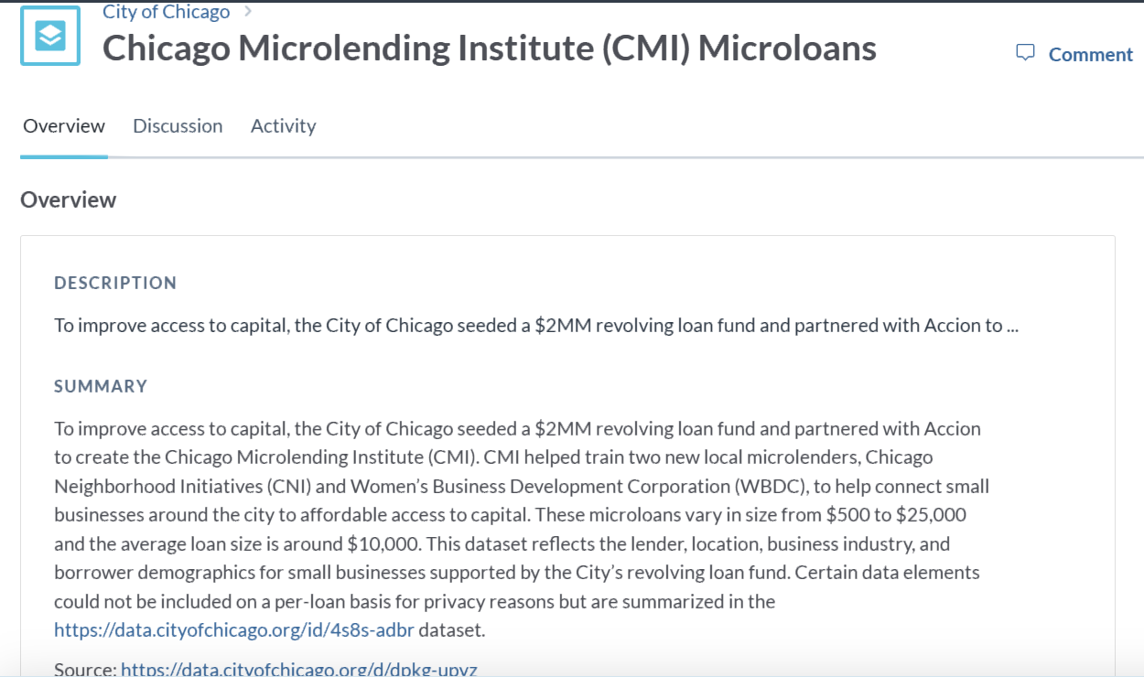
https://data.cityofchicago.org/id/dpkg-upyz
1. Data acquisition and Understanding

Slide 3
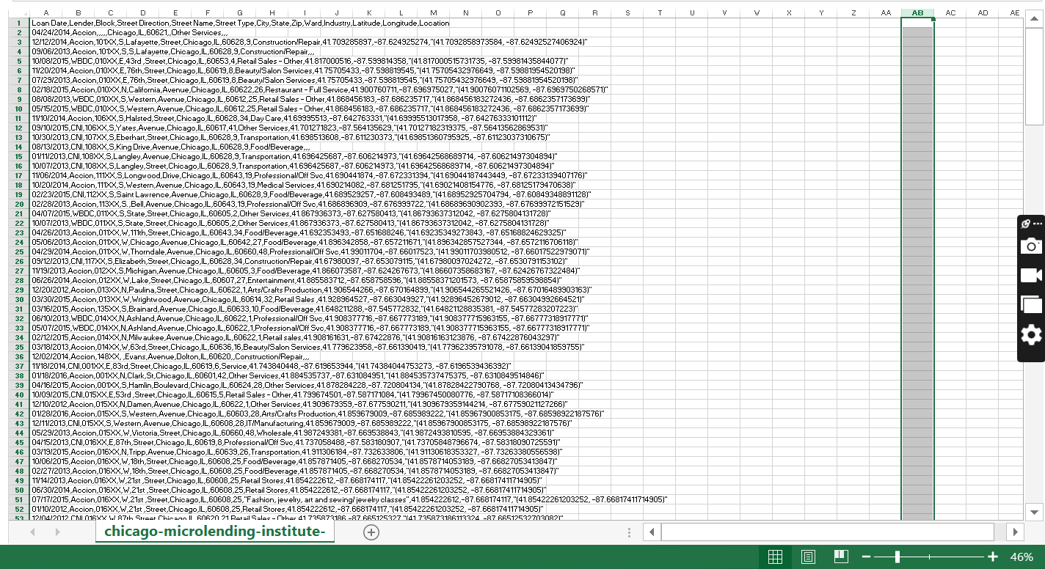
https://data.cityofchicago.org/id/dpkg-upyz
Data acquisition and Understanding: Dataset

Slide 4
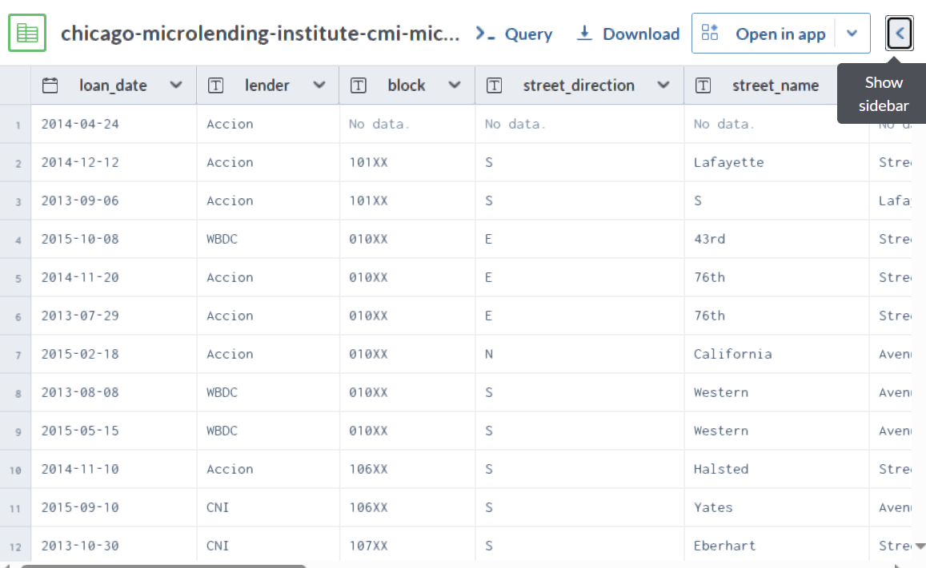
1. Data acquisition and Understanding (contd.): Data cleaning

Slide 5
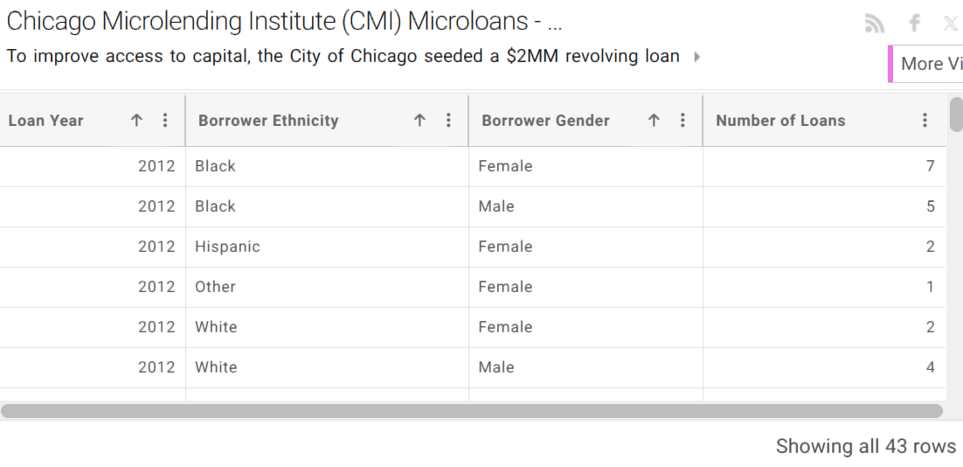
2. Data Cleaning and Preparation

Slide 6
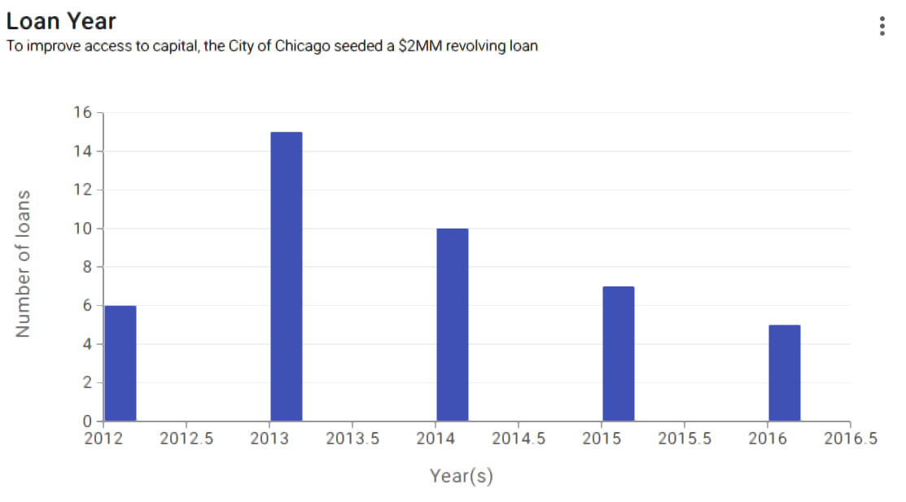
3. Descriptive Analysis

Slide 7
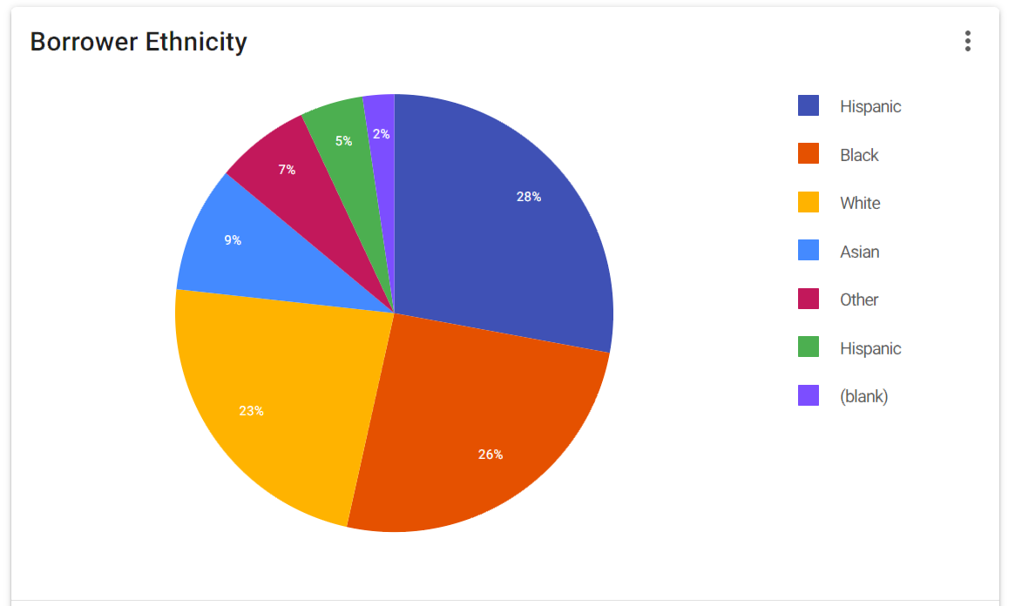
3. Descriptive Analysis

Slide 8
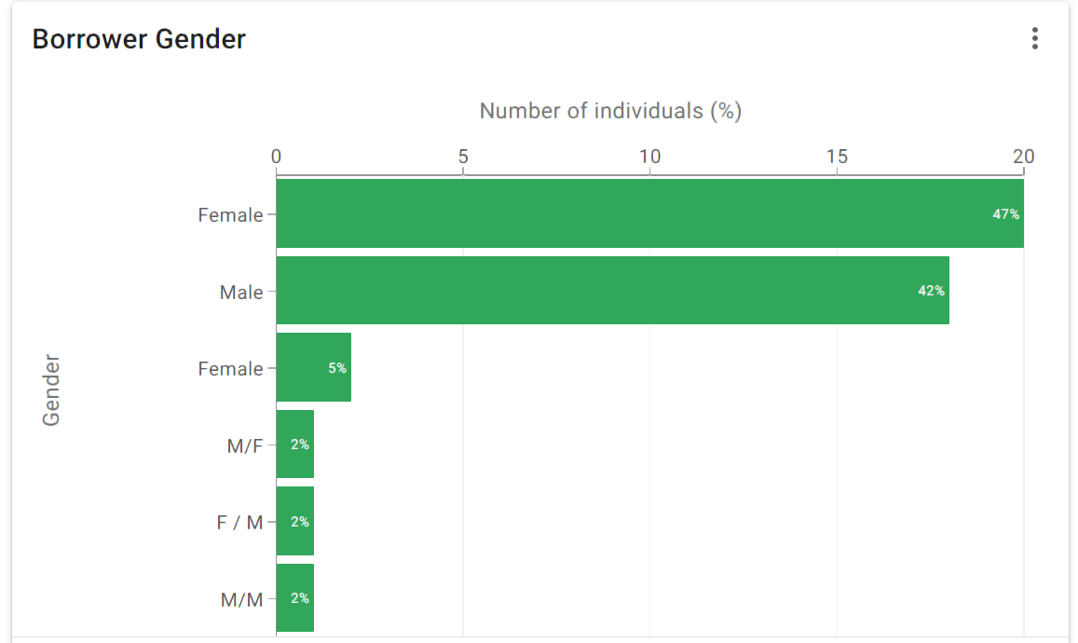
3. Descriptive Analysis(contd)

Slide 9
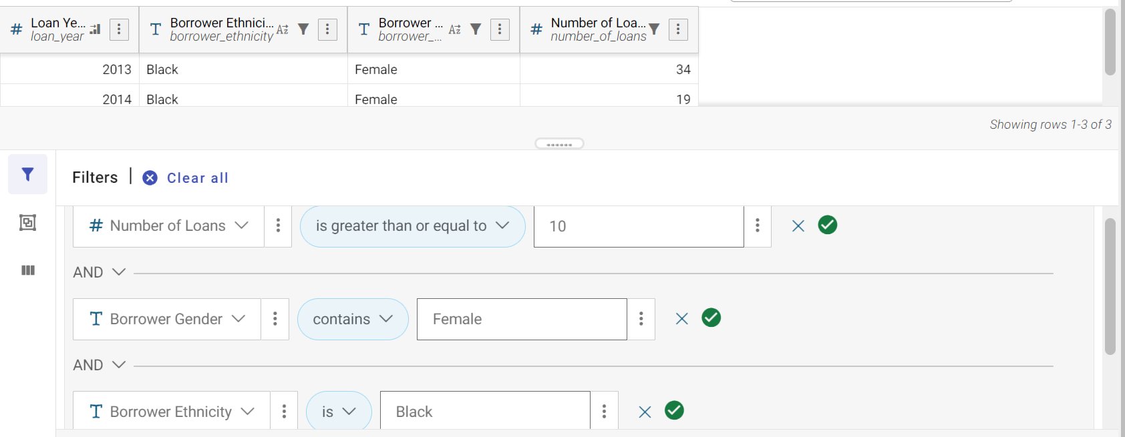
4. Segmentation and Profiling
In this section, customers were segmented according to their performance sales, race as well as gender, in order to create a solid customer profile and study customer behaviours.

Slide 10
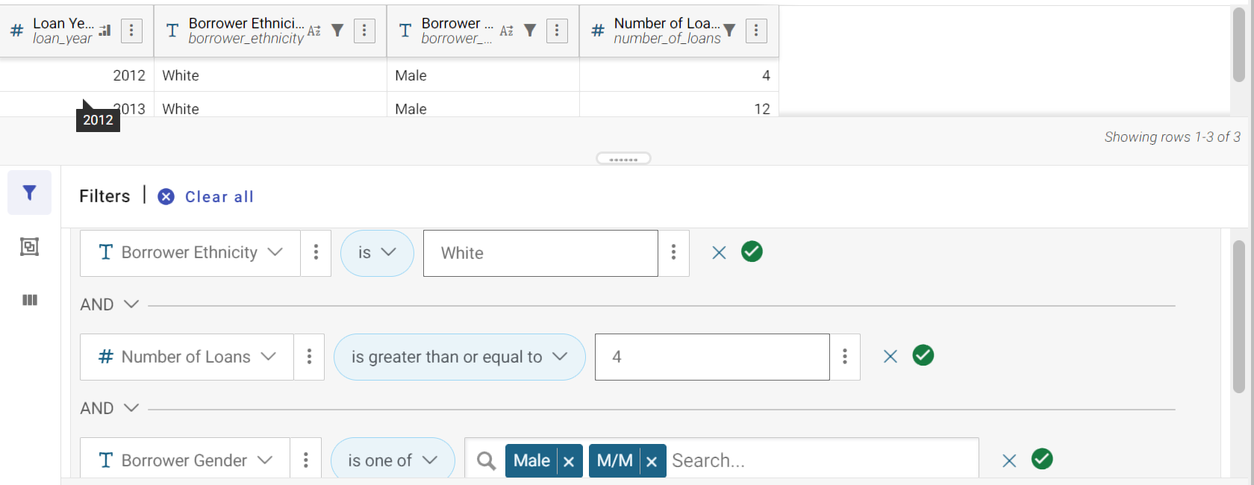
4. Segmentation and Profiling(contd.)

Slide 11
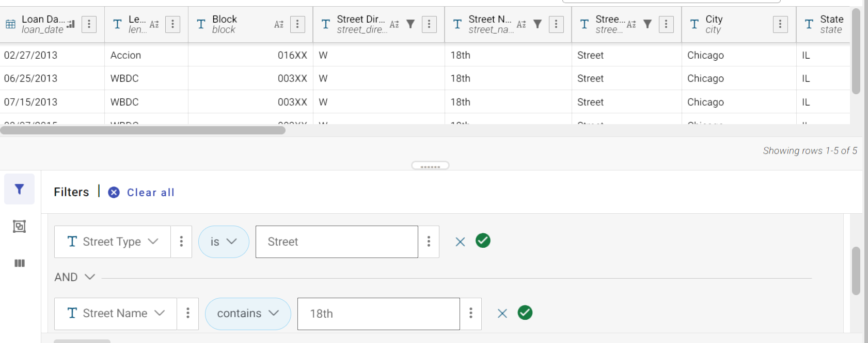
4. Segmentation and Profiling(contd.)

Slide 12
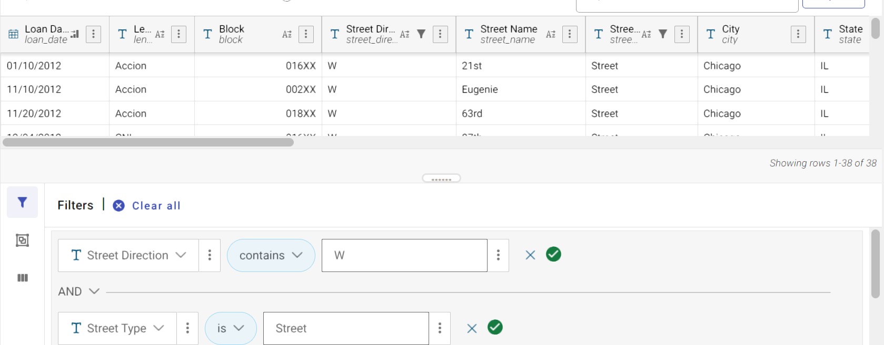
4. Segmentation and Profiling(contd.)

Slide 13
5. Correlation and Trends
In this section, we’ll be focussing on analysing correlations between different metrics. Through analysis made in the previous section we dived in a bit deeper and added more filters to our data, in order to find specific patterns and reveal certain trends.

Slide 14
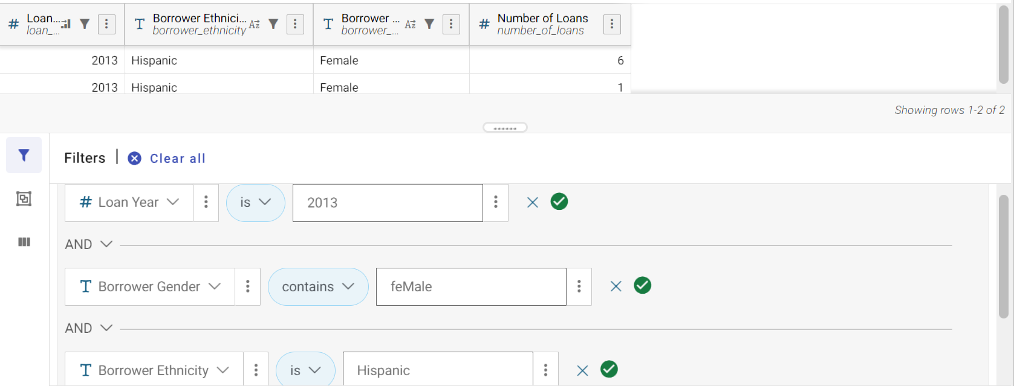
5. Correlation and Trends(contd.)
We found that, only 2 Hispanians females, were interested in taking loans, throughout the financial year of 2013, and that these two individuals correlated via gender. In 2013, a lot of loan offers could’ve been advertised to female Hispanians, to attract more tension and increase probability of more loans.

Slide 15
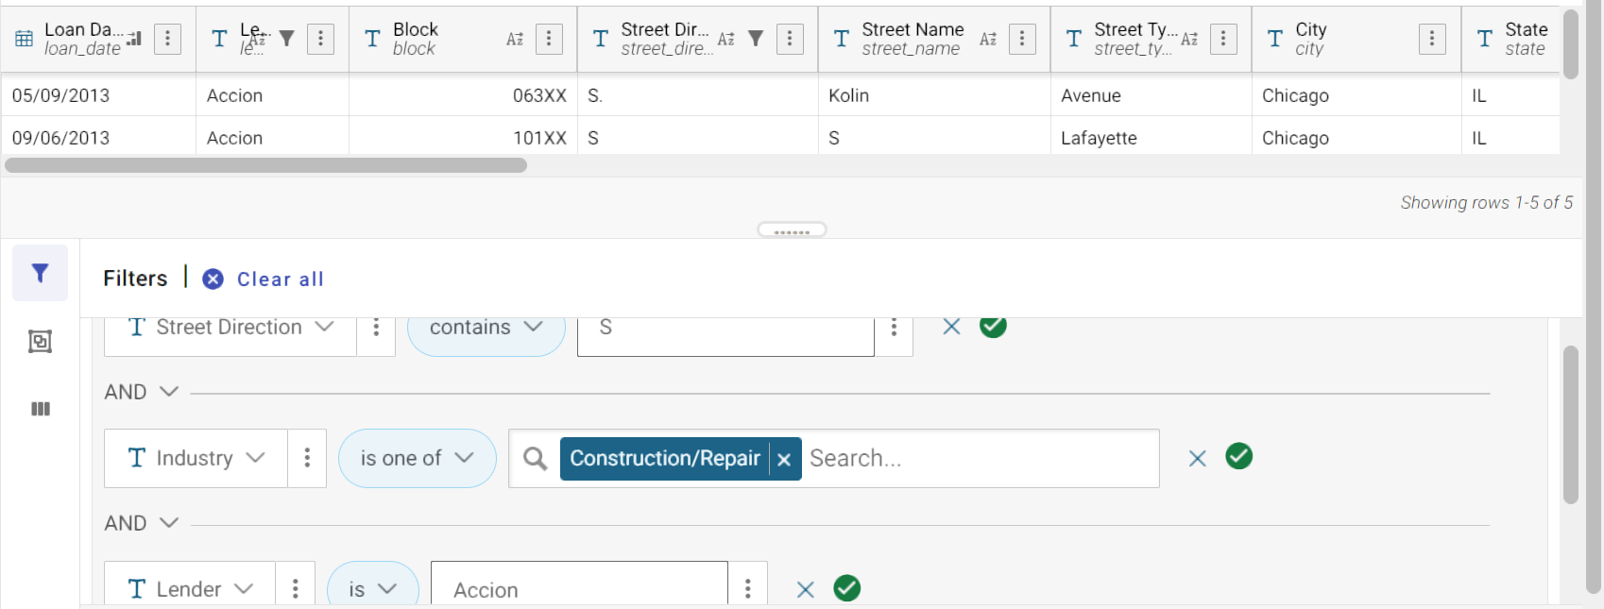
5. Correlation and Trends(contd.)

Slide 16
Thank you

